Slide 1
User-defined Functions
Dr. Asif Uddin Khan

Slide 2
Types of User-defined Functions in C
4 types of user
1. Function with no arguments and no return
value
2. Function with no arguments and a return
value
3. Function with arguments and no return value
4. Function with arguments and a return value

Slide 3
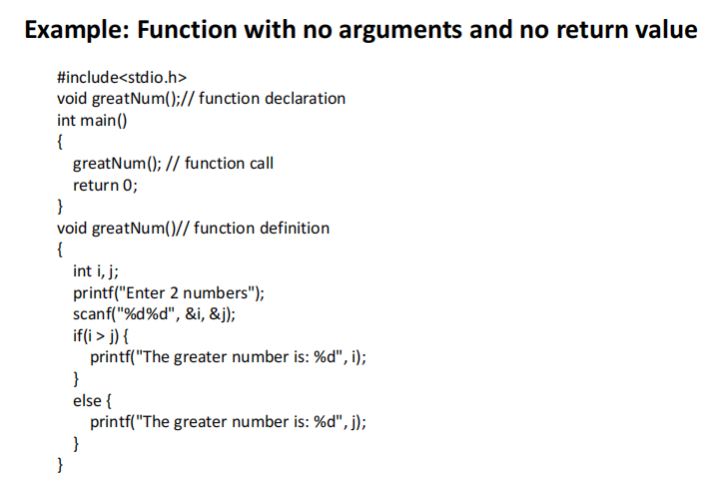

Slide 4
Passing arrays to a function in C
In C programming, you can pass entire array to functions.
Before we learn that, let's see how you can pass individual elements of an array to functions.

Slide 5
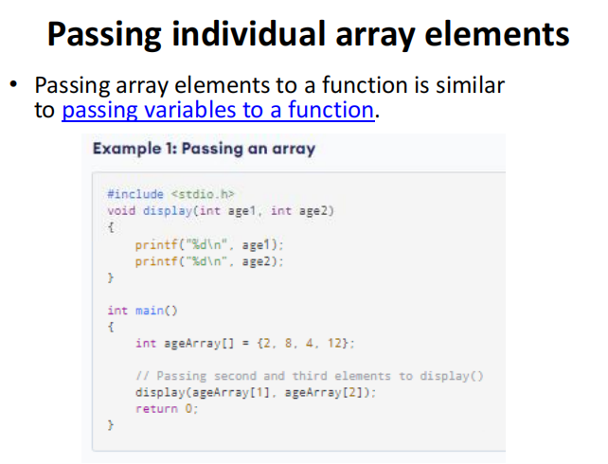

Slide 6
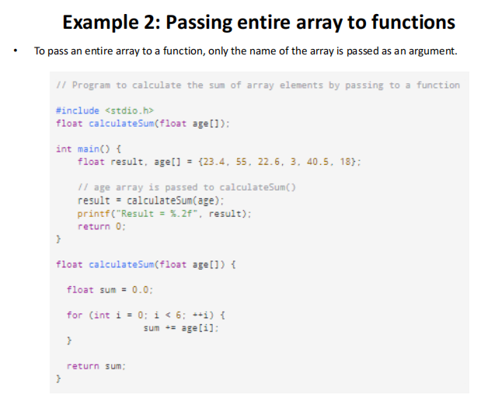

Slide 7
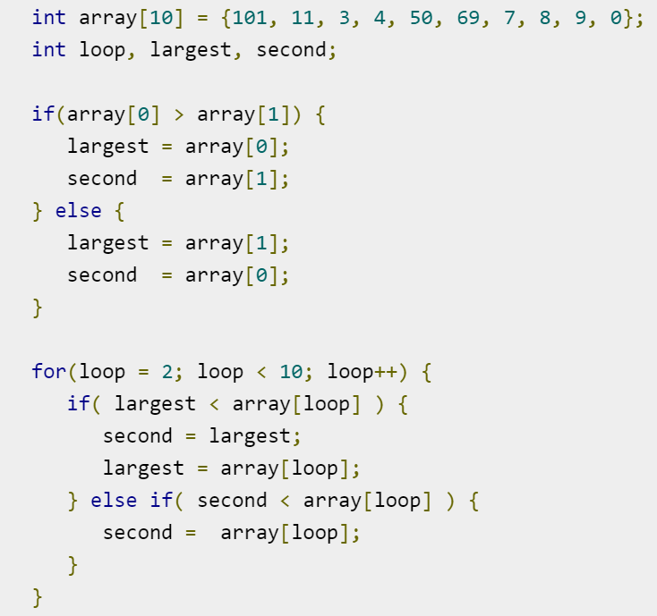
Second largest array element in C

